Slide 1




CARE Court
Implementation Update
October 2023

Slide 2
What is CARE Court?
New CIVIL COURT PROCESS established to:
Community Assistance, Recovery & Empowerment Act
Focus counties and other local governments on serving persons with untreated schizophrenia spectrum or other psychotic disorders
Provide behavioral health and housing resources and services
Protect self-determination and civil liberties by providing legal counsel and promoting supported decision making
Intervene sooner in the lives of those with multiple needs
Ensure local governments have support while driving accountability for their role
Homelessness and/or justice involvement are NOT eligibility criteria for CARE
Source: Senate Bill 1338 Community Assistance, Recovery, and Empowerment (CARE) Court Program

Slide 3

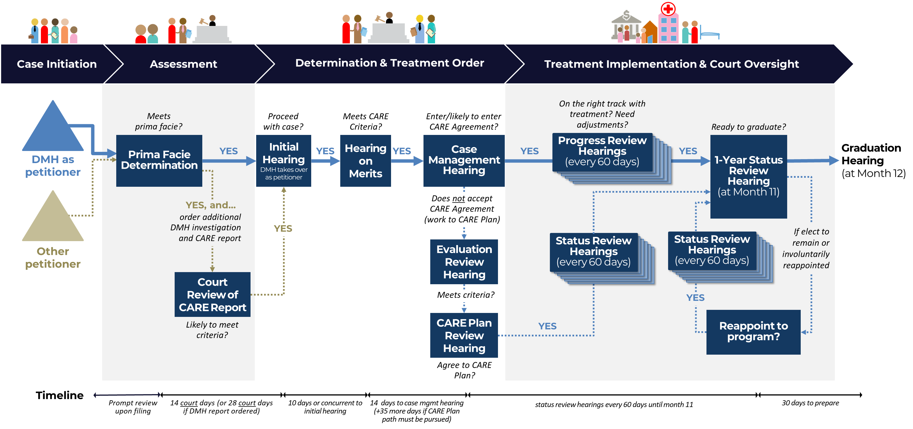
CARE Court in LA County
LOCATION: NORWALK COURTHOUSE
Base path
Additional steps for certain types of cases

Slide 4
CARE Court in LA County, cont’d
LOCATION: NORWALK COURTHOUSE
Simplified Process Flow (Base Path Only)
NOTE: Exit may be used as evidence in Public Guardian Investigation within 6 months of last CARE participation
NOTE: Possible Entry via MIST/SB317 Case Referral
1 Per SB1338, “A CARE agreement includes the same elements as a CARE plan to support the respondent in accessing community-based services and supports.”

Slide 5
Program Eligibility
Source: Senate Bill 1338 Community Assistance, Recovery, and Empowerment (CARE) Court Program § 5972

Slide 6



Possible Referral Entry Points
Referral
Form
In Draft
DMH co-located first responder teams (Fire, Police, Sheriff, EMS/TT/988/ACR); Behavior Health Provider Legal Entities & Tri-Cities; DHS & LPS Hospitals; Homeless Services Providers via HOME Team per CEO-HI Protocol
24/7 Helpline, PMRT/ ACR, Intake no-shows, DMH Website/email
Public Guardian or other LAC DMH¹?
All other community providers
Files direct with courts…perhaps with NAMI/advocate/ attorney support or Court Self Help Center (SHC) assisted party
1 TBD Given recent Judicial Partners Discussion regarding suitable alternatives with LPS Cases…CoCo and Justice Partners to discuss/consider Statutory Right of OPG to file CARE Petition
Source: Senate Bill 1338 Community Assistance, Recovery, and Empowerment (CARE) Court Program § 5974

Slide 7
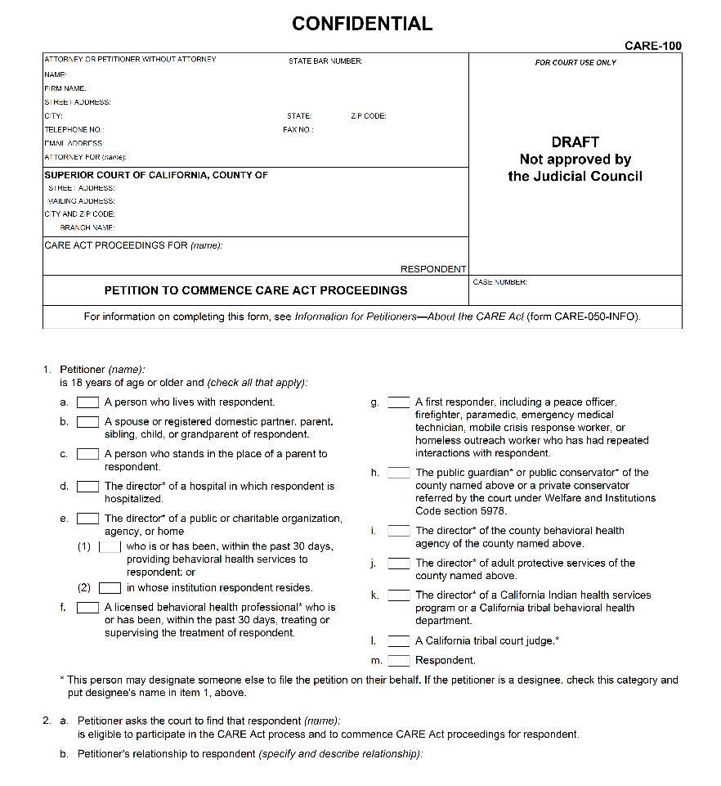

Filing a Petition
Complete petition (CARE-100) – remember to fill out all requested information
Additionally, provide the required documentation:
  Completed Mental Health Declaration (CARE-101) from licensed behavioral health provider
  - OR -
  Evidence the respondent was detained for a minimum of two periods of intensive treatment (aka WIC 5250 holds), the most recent one within the previous 60 days
Petitions can be filed in-person at Norwalk and Hollywood Courthouses and Family Law Clerk’s Office where Self-Help Centers are located.
Help for Self Represented Litigants is available at Self-Help Centers by phone (213) 830-0845, or in person.

Slide 8
Efiling of Court Documents
Petitions may be filed as of December 1, 2023
Attorneys must efile
  Efiled Petitions will be directly processed by Mental Health Clerk’s Office in Norwalk
  It is important for Attorneys to register with an EFSP before efiling their first court document. This is required for mandated efiling.
  General Order and subsequent Local Rule for efiling will be in place, effective December 1, 2023
Self Represented Litigants may efile or may file at the Family Law or Mental Health Clerk’s Office in person or by mail
  Assistance for completion of the Petition will be available from Self Help Centers.

Slide 9
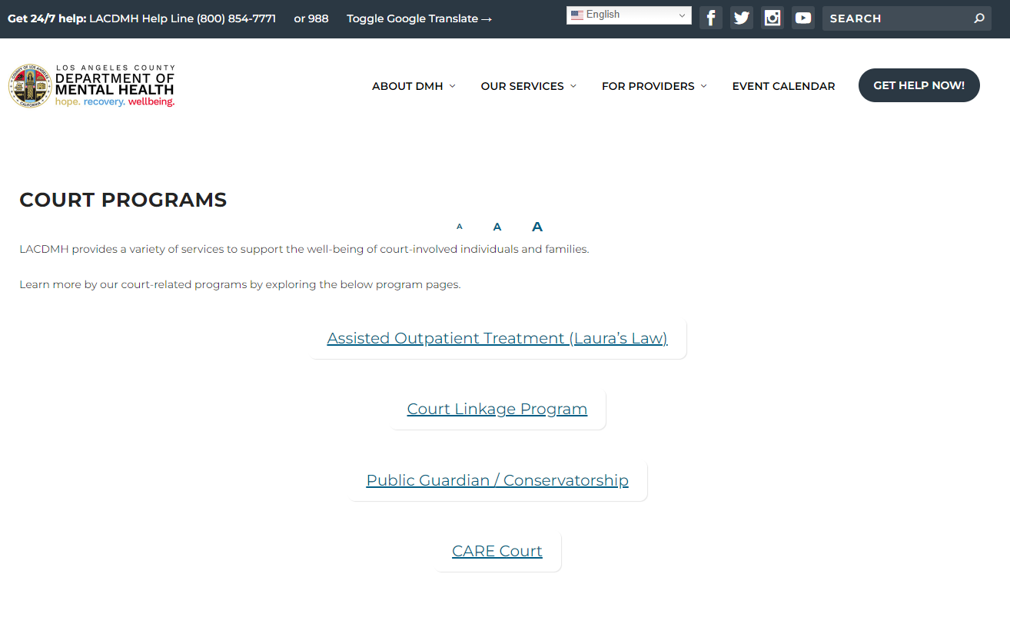
CARE Court: Referral Information & Links
**New updates**
https://dmh.lacounty.gov/court-programs/

Slide 10
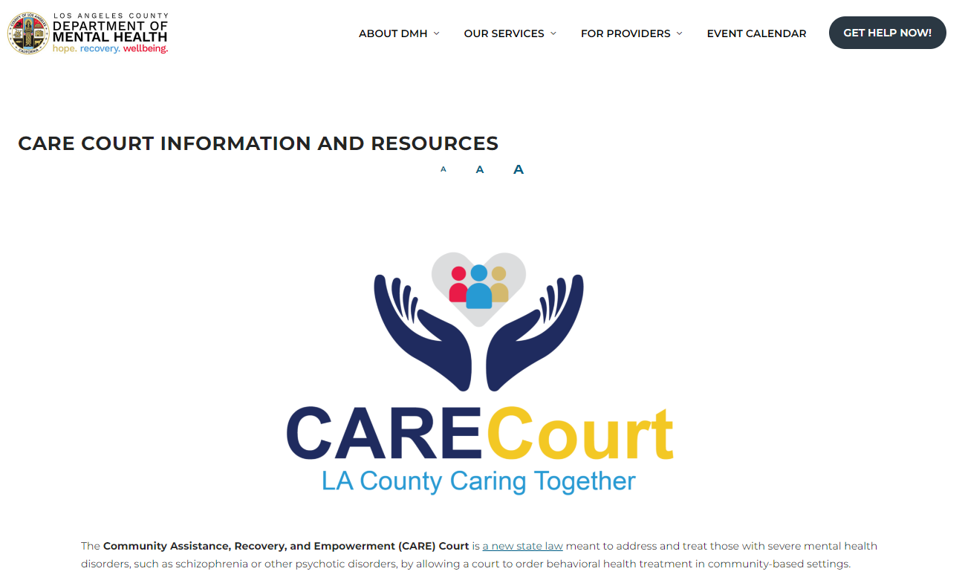
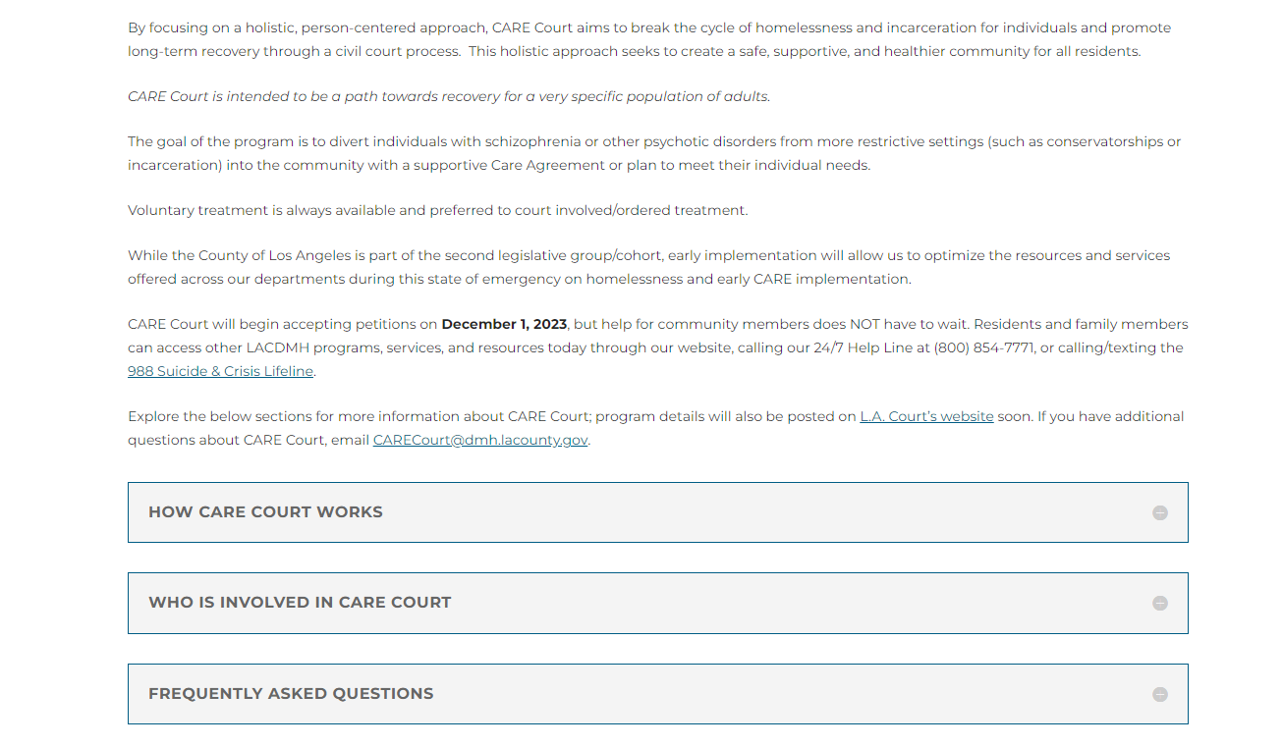
CARE Court: Referral Information & Links, cont’d
Web: https://dmh.lacounty.gov/court-programs/care-court/
Email: CARECourt@dmh.lacounty.gov
LA County CARE Court | 10

Slide 11
CARE Court: Referral Information & Links, cont’d
Court’s Webpage coming soon!
Expected to be available November 1, 2023
www.lacourt.org

Slide 12




What Is In A CARE Agreement/Plan?
Behavioral Health Services
Medications
Housing Resources
Social Services & Supports
Source: Senate Bill 1338 Community Assistance, Recovery, and Empowerment (CARE) Court Program § 5982

Slide 13
What Is In A CARE Agreement/Plan? (Housing)
County (DMH + DPH/SAPC) Housing Strategy for CARE Court Population
LA County Proposal for Behavioral Health Bridge Housing (BHBH) Program Funding - Round 1
LA COUNTY ALLOCATION Sunsets June 30, 2027 | BRIDGE HOUSING OPERATIONAL & SUPPORTIVE SERVICES $241M | Shelter / Interim Housing (90 days to 2 years)
 |  | Rental assistance that must include access to clinical and supportive behavioral health care
 |  | Housing navigation for BHBH clients Navigation includes: Participant Assistance Funds (one-time costs to move in) Landlord Outreach and Mitigation Funds
 | FLEXIBLE FUNDING CATEGORIES $80M | County BHBH program implementation
 |  | Outreach and engagement
 |  | Bridge housing start-up infrastructure
75%
TOTAL
$321M
$61M to DPH/SAPC
$260M to DMH
25%
Source: DMH Board Briefing: Behavioral Health Bridge Housing Update (April 12, 2023)
Notes:
SAPC navigation includes:
Participant Assistance Funds (one-time costs to move in)

Slide 14
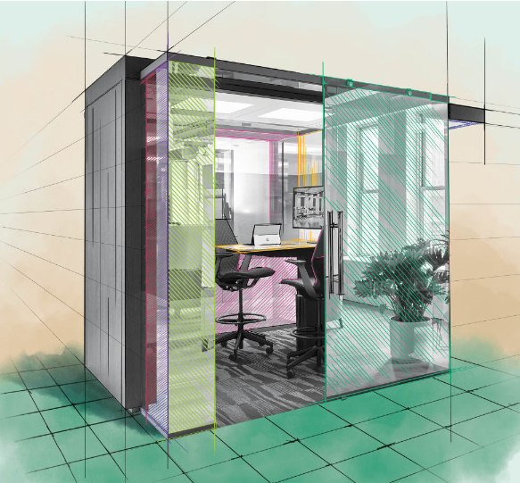
CARE Court: Equity in Access with Technology
LA Superior Court, DMH, and Mental Health Advocacy Services have MOU drafted to support Care Court participants with mutual on-site staffing in Self Help Center (SHC) at Norwalk Courthouse
SHC will use dedicated private spaces to assist community members via video and/or Microsoft Teams to link legal and/or DMH personnel in real time.
SHCs are located in 11 courthouses across LA County: Antelope Valley, Central (S.Mosk), Chatsworth, Compton, Long Beach, Pasadena, Pomona, Torrance, Whittier, Hollywood, and Van Nuys.
Additionally, SHC operates a Call Center for Self Represented Litigants (Monday-Friday)
https://www.steelcase.com/research/articles/topics/workplace/designing-with-pods/ **Illustrative for concept only**

Slide 15
CARE Court: Equity in Access with Technology, cont.
Dedicated Private Spaces may also be used for Remote Appearance to a Court Hearing in Norwalk
  HEARINGS WILL BE HANDLED IN DEPT. B OR Z IN NORWALK
  PARTIES MAY APPEAR IN PERSON, REMOTELY FROM ANY LOCATION WHERE THEY CAN ACCESS WEBEX, OR FROM A DEDICATED PRIVATE SPACE IN ONE OF 12 COURTHOUSE LOCATIONS
  JUDGE SCOTT HERIN AND JUDGE RENE GILBERTSON ARE THE DESIGNATED CARE COURT JUDICIAL OFFICERS
  ASSISTED OUTPATIENT TREATMENT CASES WILL ALSO BE HANDLED IN DEPTS. B & Z AT NORWALK.

Slide 16
CARE Court: Access and Technology
CARECourt@dmh.lacounty.gov email and website updates reference Court Programs, including links to Superior Court and state resources
www.lacourt.org will also host a CARE Court website with links to DMH site
DMH Care Court Team members available at Norwalk Court to assist with program questions and referrals/resources.
SHC will assist with completion of petitions for self represented parties, offer workshops and information about CARE Court and make referrals to DMH for information about other program and referral resources.

Slide 17



What Other DMH Programs Are Available?
CARE
Community Assistance Recovery & Empowerment Act
IMD
Institute
for Mental Disease
(Locked)
FSP
Full Service Partnership (MHSA)
5150 LPS
Psychiatric Hospital
(Locked)
Outpatient Treatment – Field Based
Outpatient Treatment – Clinic Office Based
AOT
Assisted Outpatient Treatment
Reentry Services
Outpatient Services
Crisis Stabilization
HOME
Homeless
Outreach & Mobile Engagement (Voluntary)
Most restrictive
ERS
Enhanced Residential Services
(Voluntary)
Least restrictive
CRTP
Crisis Residential Treatment Program
(Voluntary)
Notes:
HIGHLIGHTS
End this presentation by stepping back
CARE is just one part of a bigger toolkit of programs from DMH
There may be other options that are more suitable
Stress that engagement with DMH is key

Slide 18


HELP for a community member does not have to wait—please share the info below—available now…
https://dmh.lacounty.gov/988-information/
Multi-lingual service referrals, emotional support, and mental health resources available 24/7 at LACDMH Help Line
(800) 854-7771

